Slide 1
Morphology and Word Formation
in Natural Languages
Presented By: -G. Akshya
192425132
Guided By: -Dr. Ramkumar
Notes:
Introduce morphology as the study of how words are built and changed. The deck moves from morphemes and word formation to analysis, NLP pipelines, finite-state models, and one detailed case study.

Slide 2
THE BUILDING BLOCKS
Words are built from
meaningful parts
PREFIX
un
Morphology studies the internal structure of words.
Meaningful units are called morphemes.
Morphological processing supports grammar, meaning, and word relationships.
ROOT
happy
SUFFIX
ness
unhappiness → un + happy + ness
Notes:
Use unhappiness as the running example. Each part contributes structure and meaning, and together the parts explain how the word relates to other forms.

Slide 3


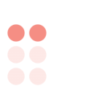

MORPHOLOGICAL ANALYSIS
01
02
03
PREFIX
ROOT
SUFFIX
un
happy
ness
Structure becomes
visible
un = prefix
happy = root
ness = suffix
Input word
1
Show a layered decomposition of UNHAPPINESS.
Identify morphemes
2
Locate the root
3
Analyze linguistic features
4
Notes:
Read the word from the outside inward. Identify the pieces, locate the root, and then use the decomposition to analyze linguistic features.

Slide 4
NLP PIPELINES
Input text
Tokenization
Morphological analysis
Morpheme segmentation
Root or lemma extraction
Linguistic features
NLP applications
NLP pipelines turn word structure into language features
Machine translation · search · spell checking · speech recognition · chatbots
Notes:
Emphasize that morphology is not an isolated linguistic exercise. The output becomes structured information that downstream NLP systems can use.

Slide 5
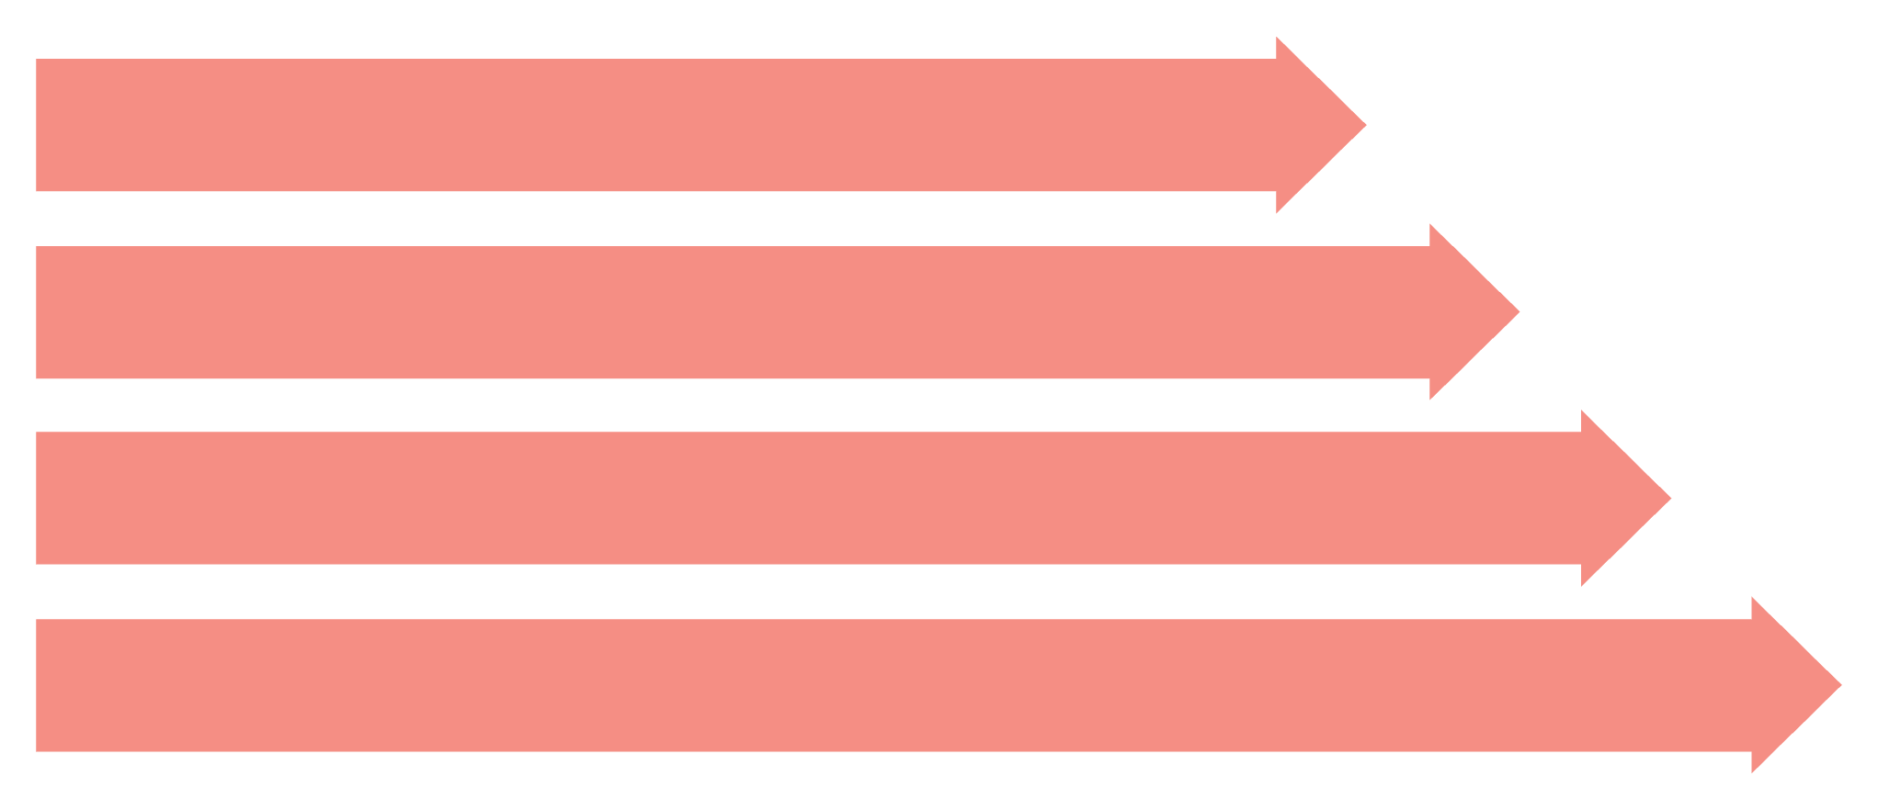
FINITE-STATE MODELS
Lexical Input
Lexical forms connect
to surface forms
Apply Rules
Surface Output
Normalization
FSA
FST
Recognizes valid morphological patterns.
Maps lexical forms to surface forms.
cat + PLURAL → cats · studies → studi · studies → study
Notes:
Use the diagram to separate recognition from transformation. An FSA checks patterns; an FST maps between representations. Stemming and lemmatization provide two different normalization outcomes.

Slide 6
CASE STUDY
Analyzing “unhappiness”
Part | Role | Contribution
un | prefix | Attached before the root
happy | root | Main meaningful part
ness | derivational suffix | Attached after the root
unhappiness → un + happy + ness → prefix + root + suffix
Compare: cats → cat + s · played → play + ed · teacher → teach + er
Notes:
Walk through each morpheme, then compare the same analytical move on cats, played, and teacher. The value for NLP is the connection between related forms.

Slide 7
08 · SYNTHESIS
Morphology strengthens language understanding, but remains challenging
Applications
Challenges
Machine translation, information retrieval, sentiment analysis, speech processing, grammar checking, text classification
Irregular words, ambiguity, language-specific rules, and rich morphology in Indian languages
Conclusion
Computational morphology helps NLP systems analyze words accurately and improve language understanding.
Notes:
Close by connecting the technical tools to the larger goal: accurate word analysis supports better language understanding, while irregularity, ambiguity, language-specific rules, and rich morphology keep the problem open.

Slide 8


